Slide 1

Azure management and governance
AZ-900: Microsoft Azure Fundamentals

Slide 2

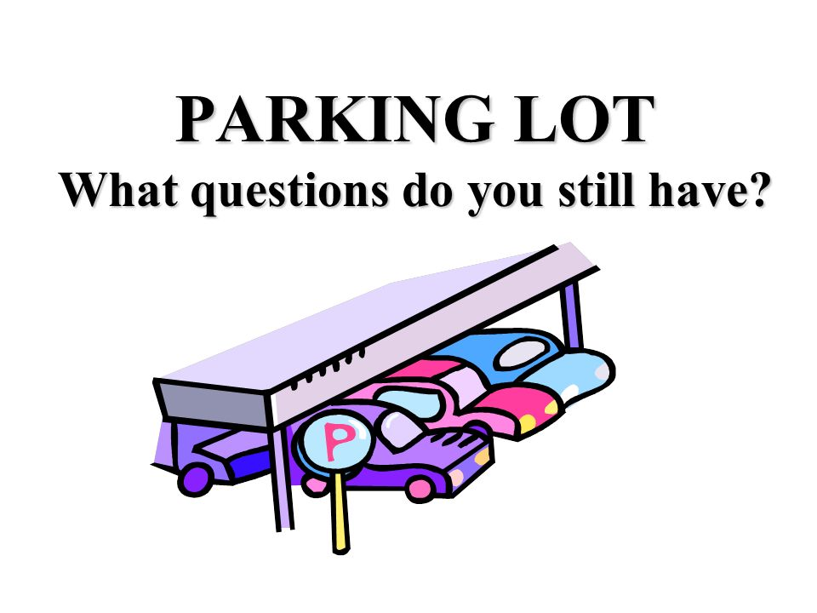
We have a Q&A Session towards the end but urgent questions are welcome (please raise your hand/use the chat)
For questions that do not require immediate response please add them to the parking lot (check chat history for link)
The questions will be answered at the end of the session or responded to in email.
Tip: If comfortable leave your name in the form so we know who to follow up with. Link to parking lot
Notes:
4:30-4:35

Slide 3
Exam objectives
TOPICS:
Describe features and tools for managing and deploying Azure resources
Describe monitoring tools in Azure

Slide 4

Topic 1:
Describe features and tools for managing and deploying Azure resources
Describe the Azure portal
Describe Azure Cloud Shell, including Azure CLI and Azure PowerShell
Describe the purpose of Azure Arc
Describe Azure Resource Manager and Azure Resource Manager templates (ARM templates)

Slide 5
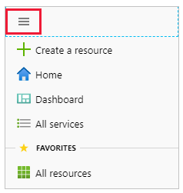
Azure Portal
The Azure portal is a web-based, unified console that provides an alternative to command-line tools
You can manage your Azure subscription with the Azure portal
You can build, manage, and monitor everything from simple web apps to complex cloud deployments

Slide 6
The Azure mobile app
it provides iOS and Android access to your Azure resources when you're away from your computer
You can Monitor the health and status of your Azure resources, Check for alerts, quickly diagnose and fix issues, and restart a web app or virtual machine (VM), Run the Azure CLI or Azure PowerShell commands to manage your Azure resources
Azure PowerShell
Azure PowerShell is a shell with which developers and DevOps and IT professionals can execute commands called cmdlets
These commands call the Azure Rest API to perform every possible management task in Azure
Azure PowerShell is available for Windows, Linux, and Mac, and you can access it in a web browser via Azure Cloud Shell.

Slide 7
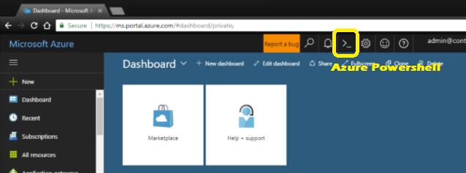

Azure PowerShell
Azure CLI
The Azure CLI command-line interface is an executable program with which a developer, DevOps professional, or IT professional can execute commands in Bash
it can run on Windows, Linux, and Mac, and can be accessed in a web browser via Cloud Shell.

Slide 8
ARM templates
Although it's possible to write imperative code in Azure PowerShell or the Azure CLI to set up and tear down one Azure resource, By using Azure Resource Manager templates (ARM templates), you can describe the resources you want to use in a declarative JSON format
The benefit is that the entire ARM template is verified before any code is executed to ensure that the resources will be created and connected correctly. The template then orchestrates the creation of those resources in parallel. if you need 50 instances of the same resource, all 50 instances are created at the same time

Slide 9
Azure Advisor
Azure Advisor evaluates your Azure resources and makes recommendations to help improve reliability, security, and performance, achieve operational excellence, and reduce costs
When you're in the Azure portal, the Advisor dashboard displays personalized recommendations for all your subscriptions, and you can use filters to select recommendations for specific subscriptions, resource groups, or services
Azure Service Health
Azure service health provides a personalized view of the health of the Azure services, regions, and resources you rely on.
You can set up alerts that help you triage outages and planned maintenance.

Slide 10
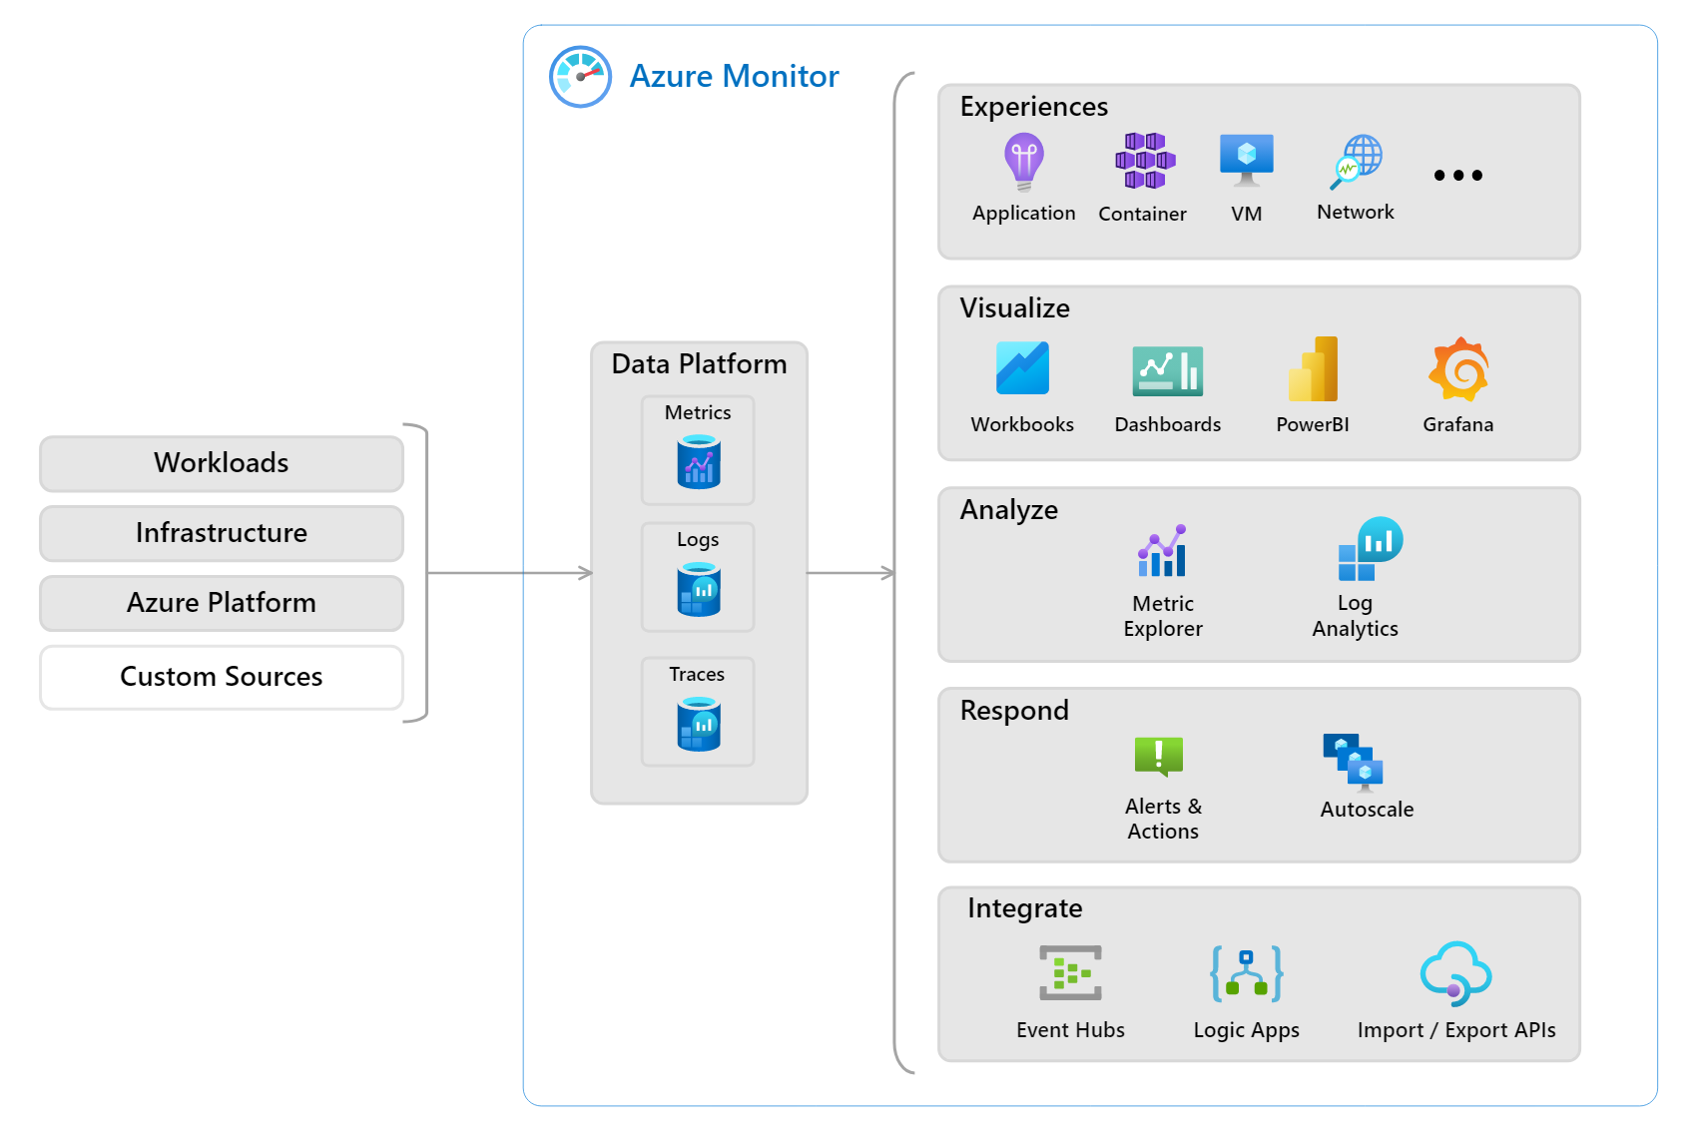
Azure Monitor
Azure Monitor is a platform for collecting, analyzing, visualizing, and potentially taking action based on the metric and logging data from your entire Azure and on-premises environment

Slide 11
References:
https://docs.microsoft.com/en-us/learn/modules/ai-machine-learning-fundamentals/1-introduction
https://www.linkedin.com/learning/paths/prepare-for-the-azure-fundamentals-certification-az-900
https://docs.microsoft.com/en-us/azure/logic-apps/logic-apps-overview

